Slide 1

INTRODUCTION
REACT
Powered by: App Innovation Technologies Pvt Ltd

Slide 2
INDEX
INTRODUCTION
WHAT IS REACT?
WHY REACT?
FEATURES AND BENIFTS
INSTALLATION PROCESS
Powered by: App Innovation Technologies Pvt Ltd

Slide 3

WHAT IS REACT?
ReactJS is a declarative, efficient, and flexible JavaScript library for building reusable UI components
It is an open-source, component-based front end library responsible only for the view layer of the application
It was created by Jordan Walke
Facebook developed ReactJS in 2011 in its newsfeed section, but it was released to the public in the month of May 2013
Today, most of the websites are built using MVC (model view controller) architecture. In MVC architecture, React is the 'V' which stands for view, whereas the architecture is provided by the Redux or Flux.

Slide 4
WHY REACT SO POPULAR?
Less complex than the other alternatives
At the time when React was announced, Ember.js and Angular 1.x were the predominant choices as a framework.
Both these imposed so many conventions on the code that porting an existing app was not convenient at all.
React made a choice to be very easy to integrate into an existing project, because that’s how they had to do it at Facebook in order to introduce it to the existing codebase.

Slide 5
Perfect Timing
At the time, Angular 2.x was announced by Google, along with the backwards incompatibility and major changes it was going to bring.
Moving from Angular 1 to 2 was like moving to a different framework, so this, along with execution speed improvements that React promised, made it something developers were eager to try.

Slide 6
Backed by Facebook
Being backed by Facebook is, of course, going to benefit a project if it turns out to be successful.
Facebook currently has a strong interest in React, sees the value of it being Open Source, and this is a huge plus for all the developers using it in their own projects.

Slide 7
Is React simple to learn?
React is simpler than alternative frameworks
React in itself has a very small API, and you basically need to understand 4 concepts to get started:
1.Components
2.JSX
3.State
4.Prop

Slide 8
BENEFITS OF REACTJS:
Easy to learn and use
Creating dynamic web applications become easier
Reusable components
Performance Enhancement
The support of handy tools
Known to be SEO friendly
Benefits of having javascript library
Scope for testing the codes

Slide 9
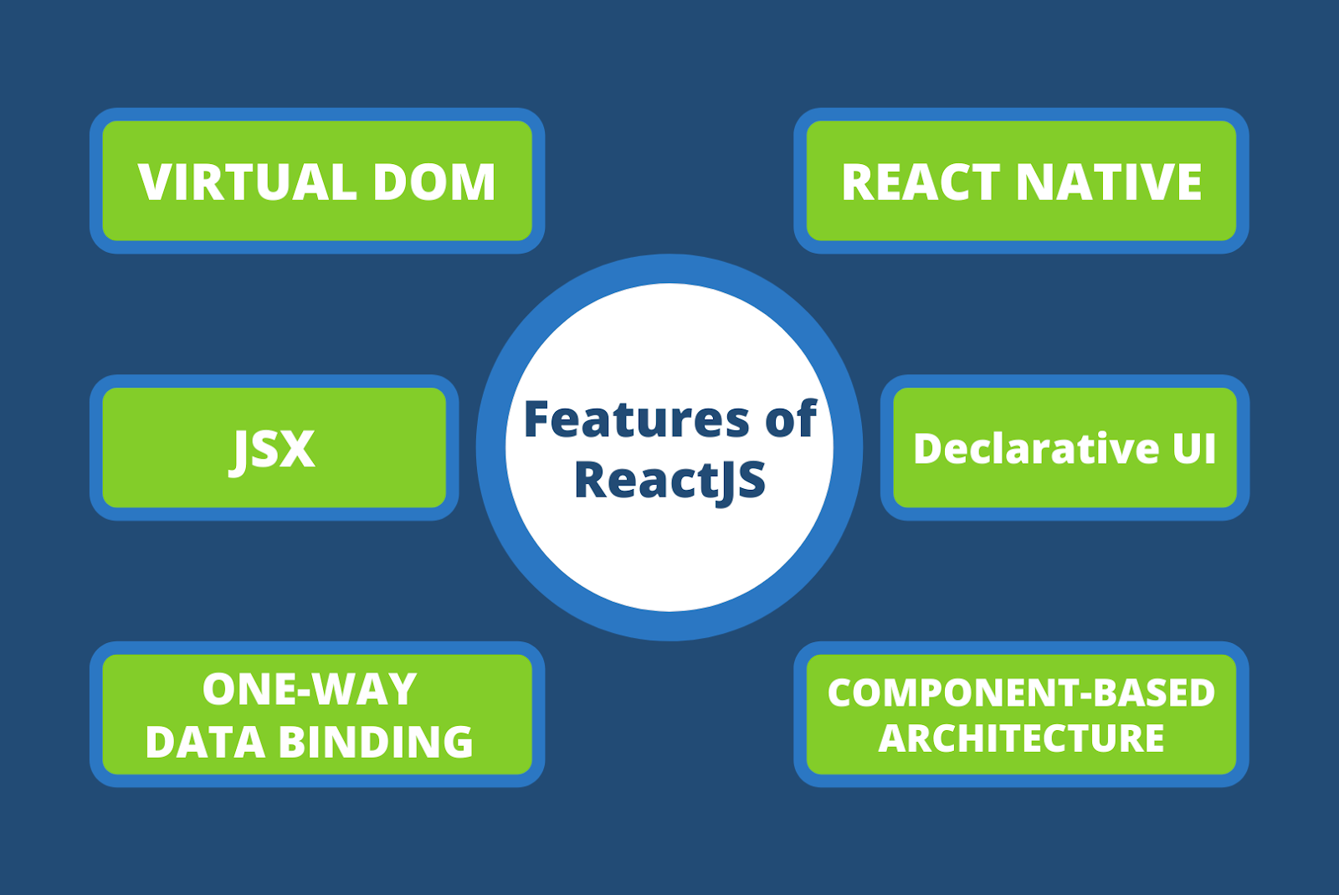
FEATURES OF REACT:
JSX
Compoents
One-way data binding
Virtual DOM
Simplicity
Performance

Slide 10
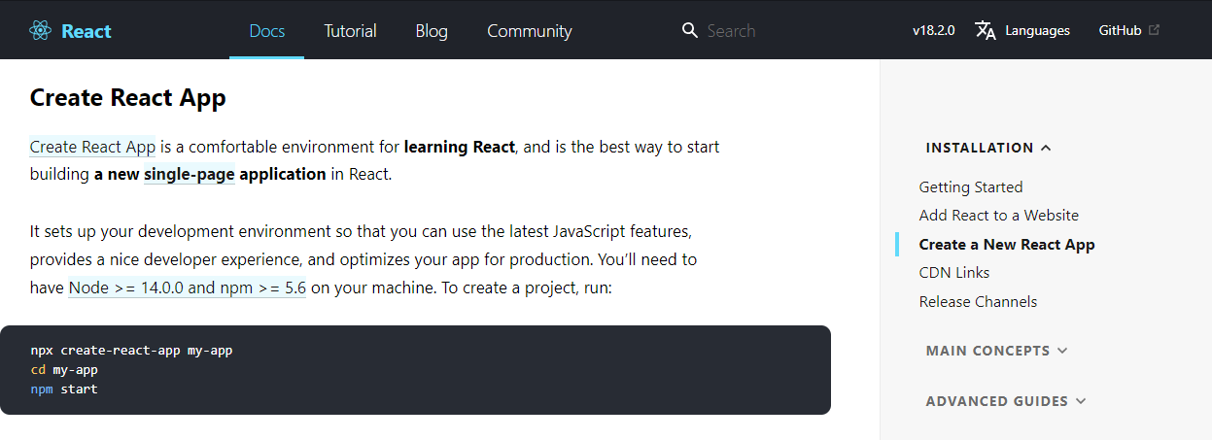
HOW TO INSTALL REACT?
Open Create React App
Enter the code in terminal
Download and install the Application

Slide 11
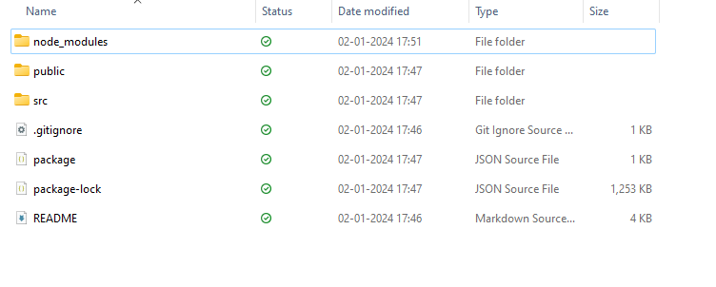
Open command prompt and enter node -v
Create new folder in desktop and click shift + right key and open the open power shell terminal
Enter the code npx create-react-app sample-react-app(folder name)
cd folder name
npm start.

Slide 12
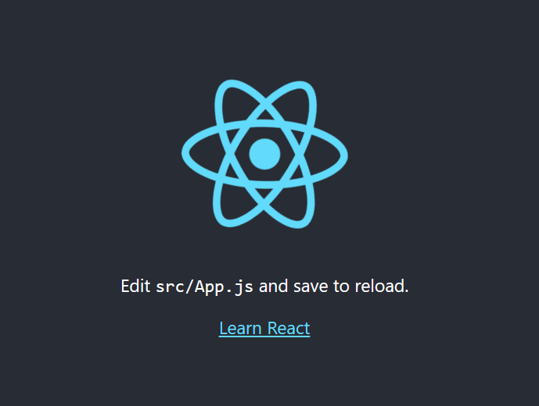
Give access react page will load
Open the project folder again shift + right key open with power shell enter code(space) .
Visual studio code page will open
Open Terminal and enter npm start
Open app.js

Slide 13
THANK YOU
Powered by: App Innovation Technologies Pvt Ltd

